Slide 1
Data Acquisition and Transmission
Temperature Sensing of a 3D Printer‘s Hotend
Metin Oktay Yılmaz

Slide 2
Contents:
Job Description and Definitions
Requirements
Component/Architecture Selection and Their Characteristics
Feasibility Study
Findings / Discussion

Slide 3
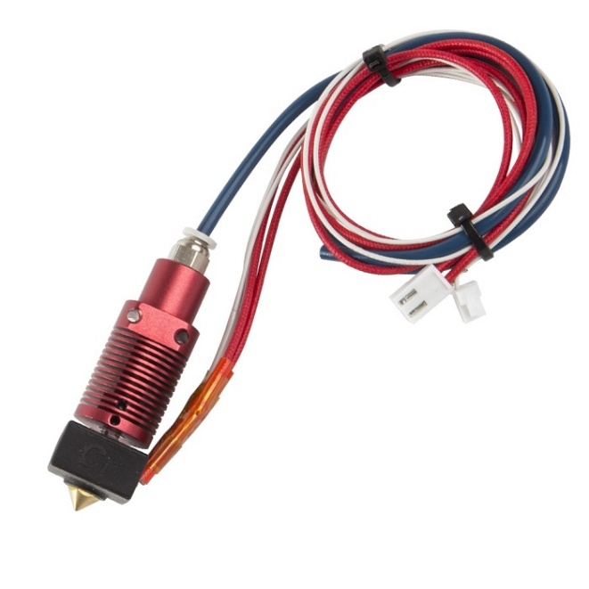
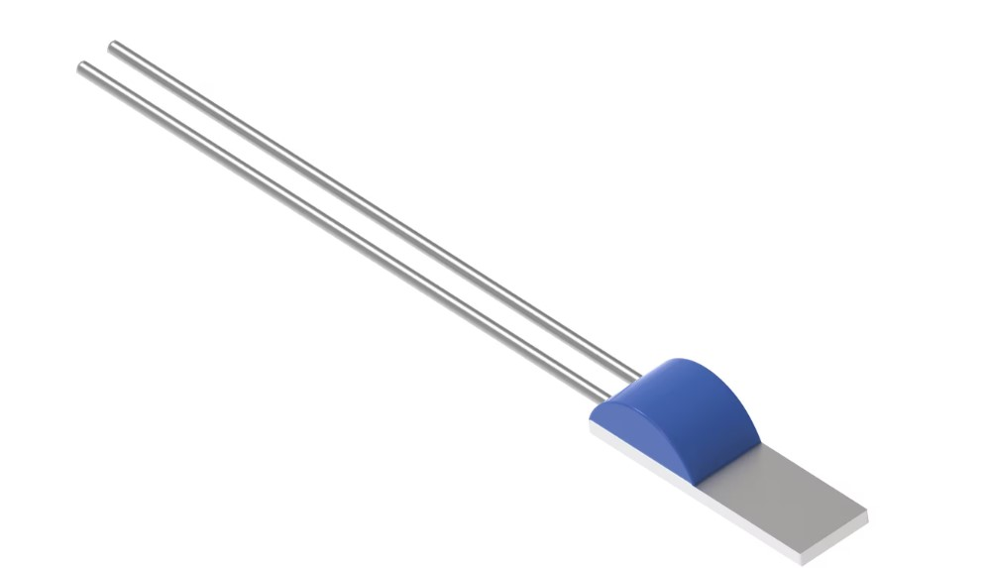
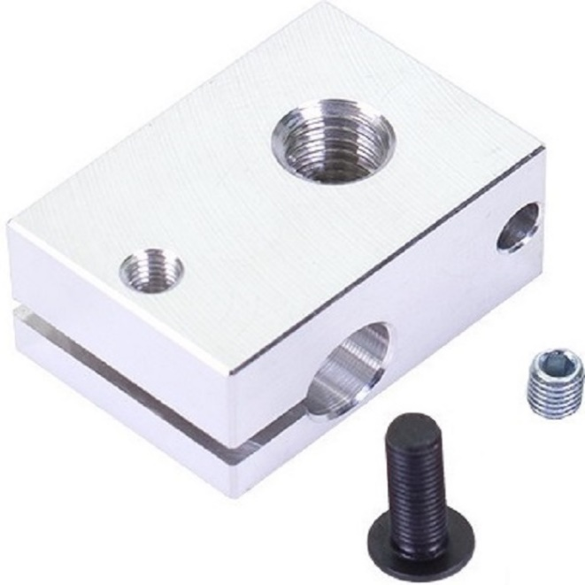
Job Description & Definitions
Short description: Sense the temperature of a 3D printer’s hotend
with a PTC1000 thermistor
10 mm
Hotend
PTC1000
Heater Block

Slide 4
Requirements
 | a | b
1 | Size: Max 3x3x3 mm | Accuracy: ± 1 ◦C
2 | Weight < 2 grams | Voltage Divider Architecture
3 | Measurement range: 20 - 270 ◦C | Power consumption < 50 mW
4 |  | ADC: 10 bits resolution, 0 - 5V range, rounding-based

Slide 5
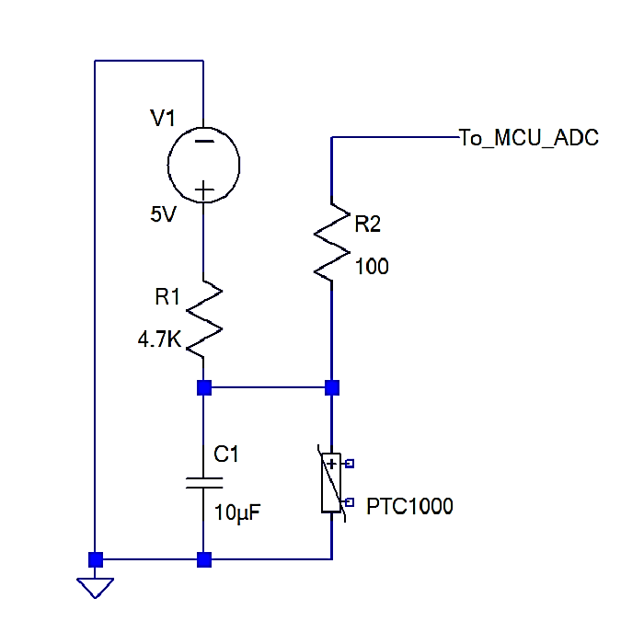
Voltage Divider

Slide 6
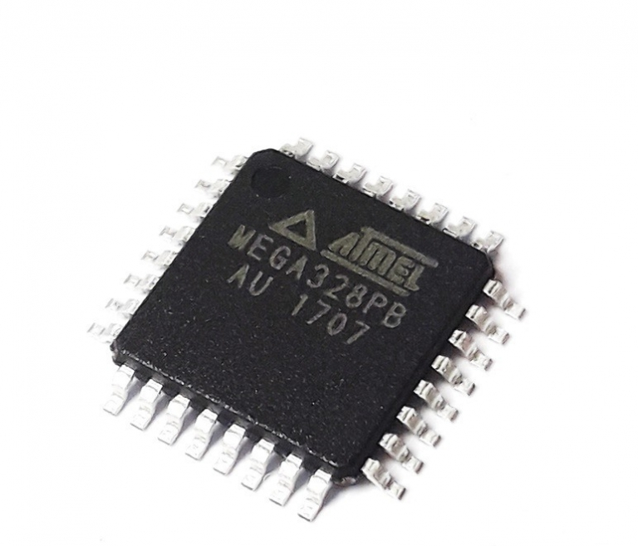
Component Selection
www.microchip.com*
www.te.com
*Microchip acquired Atmel in 2016

Slide 7
Component Selection: Atmega328PB
 | Specifications
1. | 1. 10-bit Resolution
2. | Rounding based schema
3. | ±2 LSB Absolute Accuracy
4. | Up to 76.9 kS/sec (Up to 15 kS/sec at max resolution)
5. | 0 - VCC ADC Input Voltage Range
6. | 3.41 $/unit
www.microchip.com*
*Microchip acquired Atmel in 2016

Slide 8
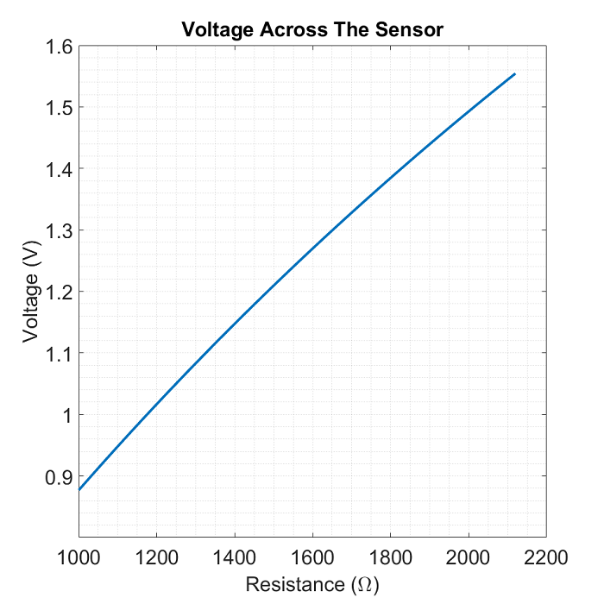

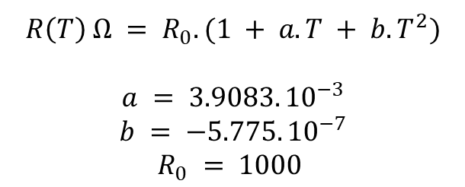
Component Selection: TE PTC1000
 | Specifications
1. | DIN EN 60751 compatible
2. | From -50 to +600 °C
3. | Low resistance drift over lifetime
4. | Fast response time thanks to low thermal mass
5. | 1.76 $/unit
www.te.com
Figure: Voltage across the sensor in the voltage divider

Slide 9

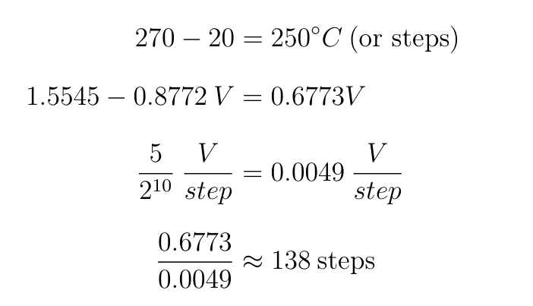



Feasibility Study: Electrical Requirements
Requirement 4b: 0 – 5V range
Requirement 1b: 1°C/step
Figure: Voltage across the sensor in the voltage divider
Requirement 4b
Requirement 1b
www.te.com

Slide 10




Power Consumption
Requirement 3b: <50 mW
Ω
Ω
Requirement 3b

Slide 11
Result
Physical requirements are met.
Electrical requirements are, except for one, met.
Due to the unmet requirement of accuracy, which is caused by ADC resolution, this project is not feasible.

